Slide 1




How to prepare for a job interview
TOP10 advice
Sara Hacheche

Slide 2

1. Prepare for your interview
It is your first direct contact with the recruiter.

Slide 3
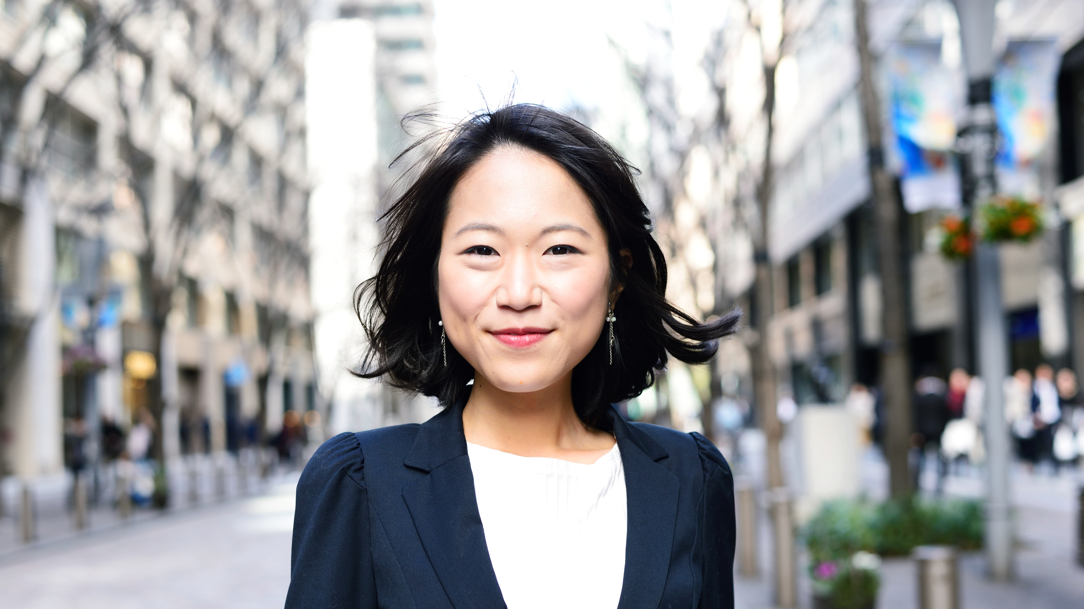
To be punctual and adopt a professional an outfit and attitude.

Slide 4

Smile

Slide 5

Avoid language tics
"Uh... So... Actually..."

Slide 6

Speak yes... But also listen!

Slide 7

Relax In a few words: be yourself!

Slide 8

Ask the right questions
At the end of the interview, your interviewer will likely ask you if you have any questions. This is an opportunity to seize to finally convince the recruiter.

Slide 9
In conclusion
Make a difference in your interview by being prepared and professional

Slide 10
Thank you very much for listening to me dear comrade
https://thestartupelevator.com/recherche-emploi-conseils-decrocher-rapidement-job/
https://www.eotim.com/Cabinet-de-recrutement-informatique-et-IT-%C3%A0-Paris-et-Caen/eotips-7-10-conseils-pour-r%C3%A9ussir-son-entretien-dembauche-1464794035765.html

